Slide 1
Indian Sign Language Recognition
DIP - 4
Team members :
Chandan Kumar
Anshul Sharma
Sachin Naik
Anant Kumar
Abhay yadav
Balwant Yadav

Slide 2
Indian sign language and previous works
Sign language recognition is a very well researched topic for the sign languages of other countries , especially the American Sign Language (ASL). But for the Indian sign language (ISL) , very few research has been done in recognizing letters.
The previous works which are done on the recognition of the signs of Indian Sign Language only considers the characters of english alphabet (A-Z) . Now it is extremely difficult for a person with actual speaking or listening disability to express himself letter by letter. This is why we decided to chose the signs for the words of our everyday life such as work , walk , me , you , etc. as provided by the Indian government.

Slide 3
Indian Sign Language.
The project ISL(Indian sign language ) recognition is divided mainly into five stages:
1 Selection of Symbols
2 Collection of data set
3 Data processing
4 Training
5 Recognition of gesture

Slide 4
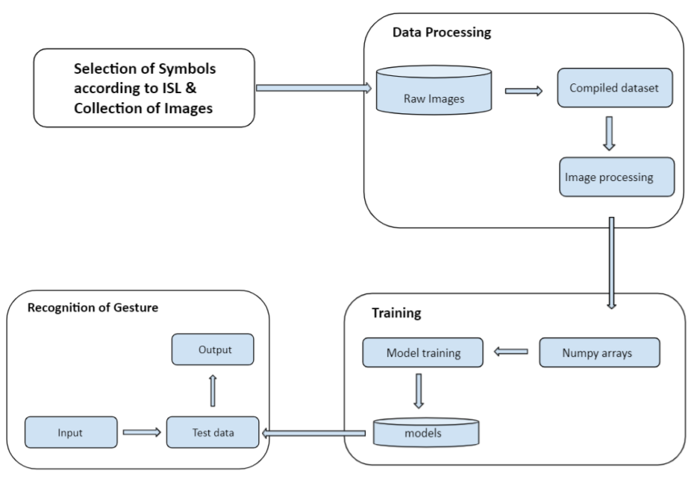
Overview of our project

Slide 5
1 Selection of Symbols
First of all we choose 83 symbols according to the ISL. The word we choose is used in daily life. The list of symbols we have selected for this project are listed in the below docs link.
Link- https://docs.google.com/document/d/1hOa80f_Vfl4ukaVDBfETfqPw7ZnnNqGi1mSjZQ3ILx4/edit?usp=sharing

Slide 6
2 Collection of data set
Secondly we have to collect a raw data set of about 5200 images for the selected 83 signs of the indian sign language on our own i.e. about 62 images for all the symbols we have chosen. These 83 symbols are not selected as random but we carefully chose those words which we use in our everyday life from the website of Indian sign language research and training centre.
Link: http://www.islrtc.nic.in/
Everyday terms dictionary : https://drive.google.com/drive/folders/1fAruK7eS-SexL6SOPIrWsEqsnGq4AT9i

Slide 7
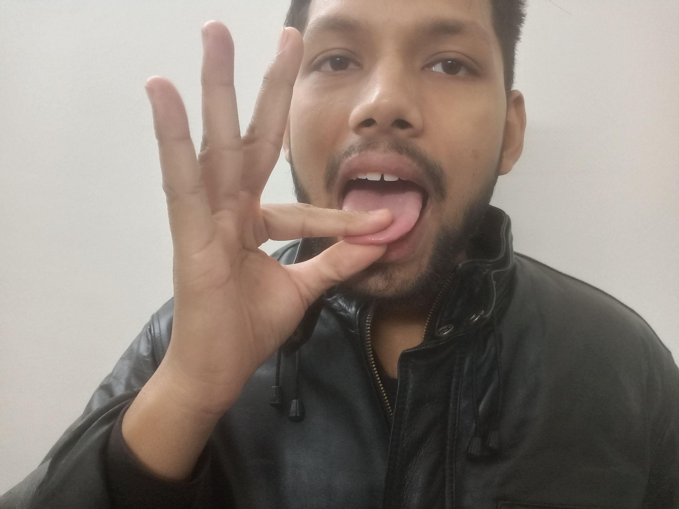
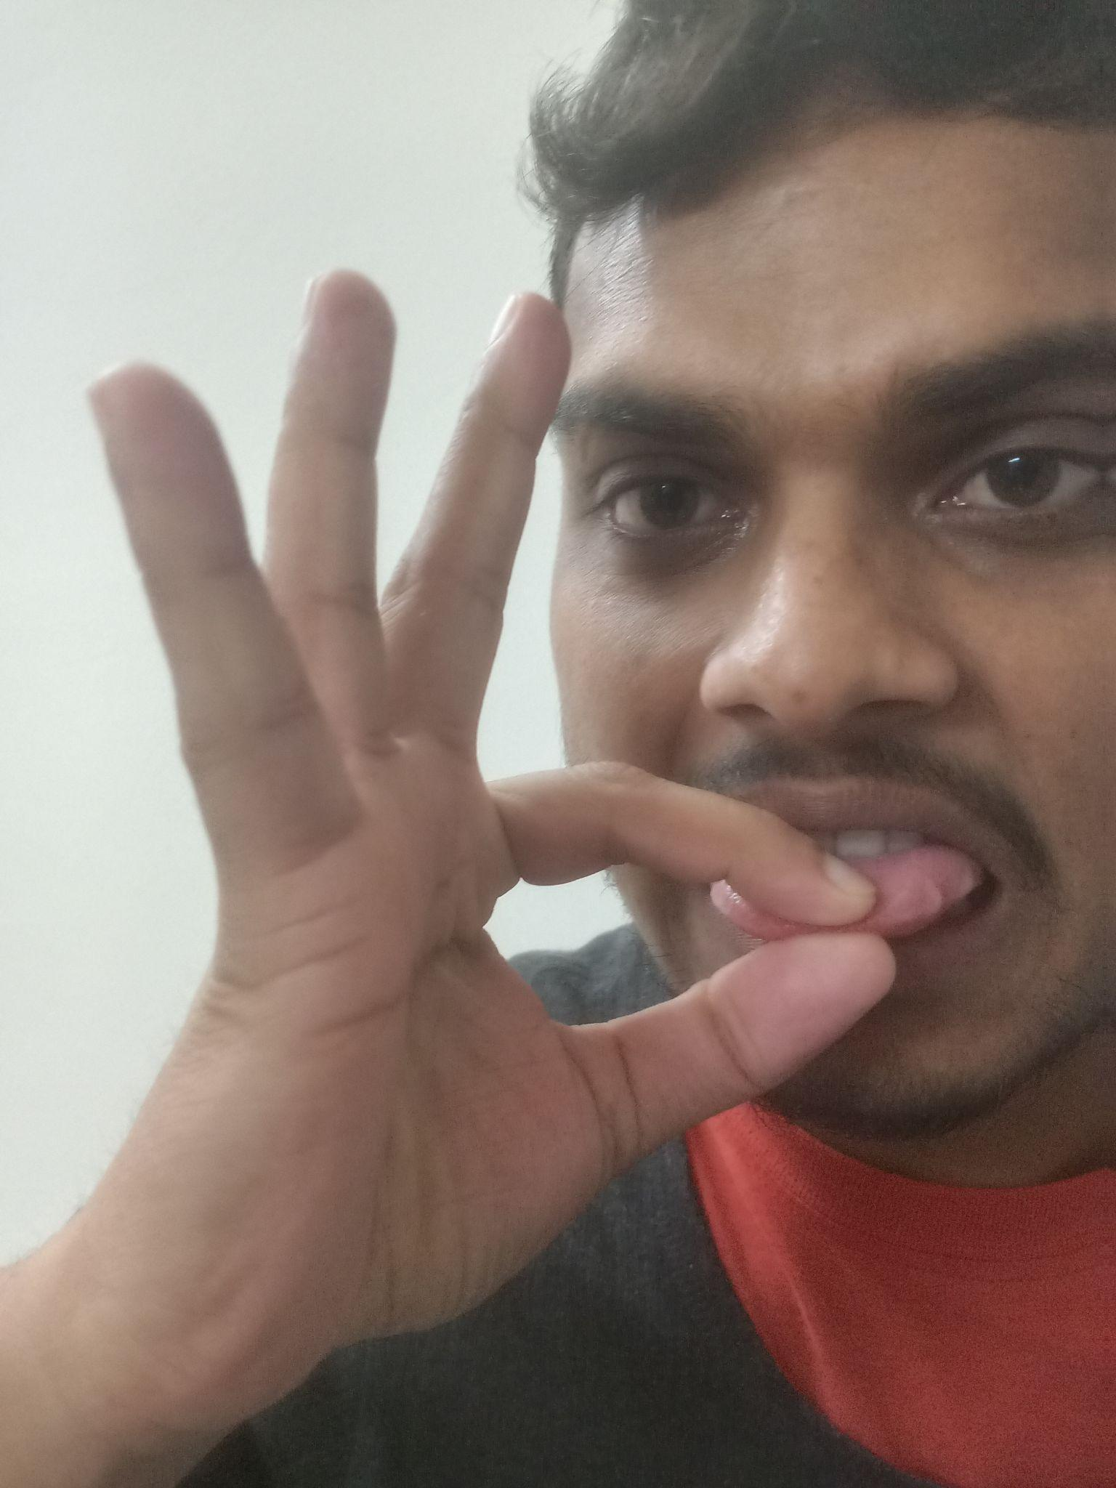
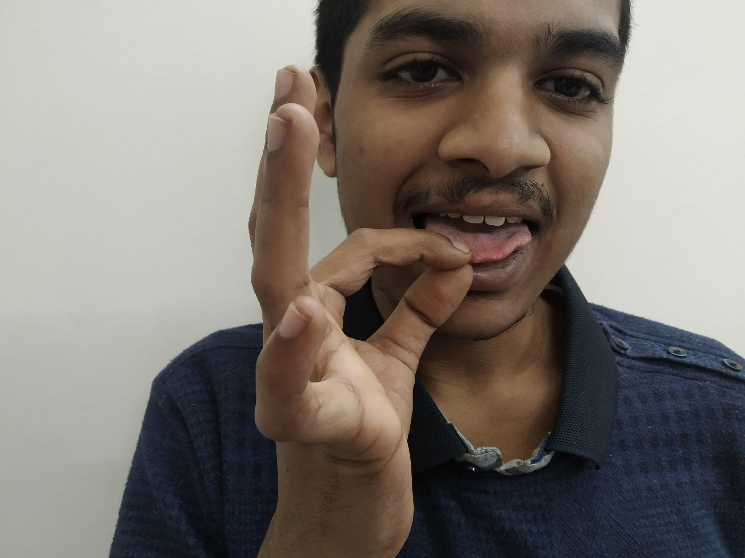
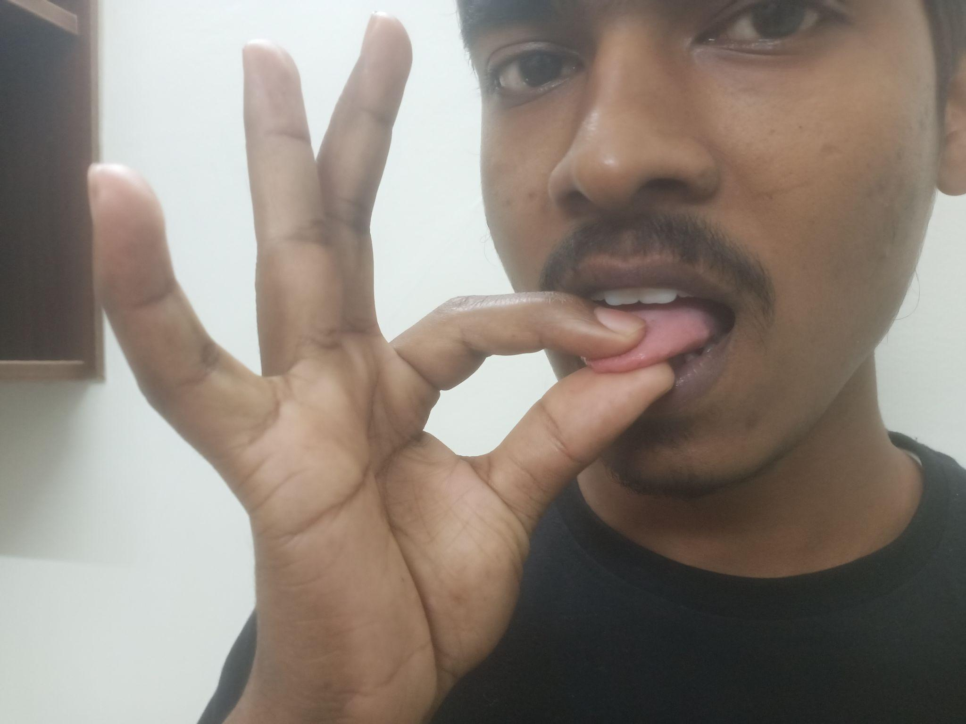
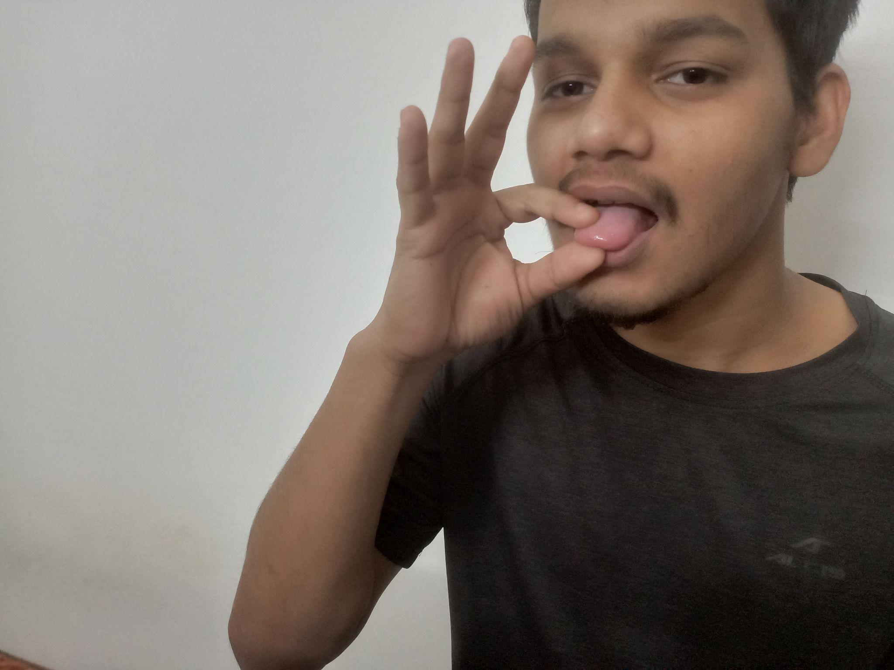
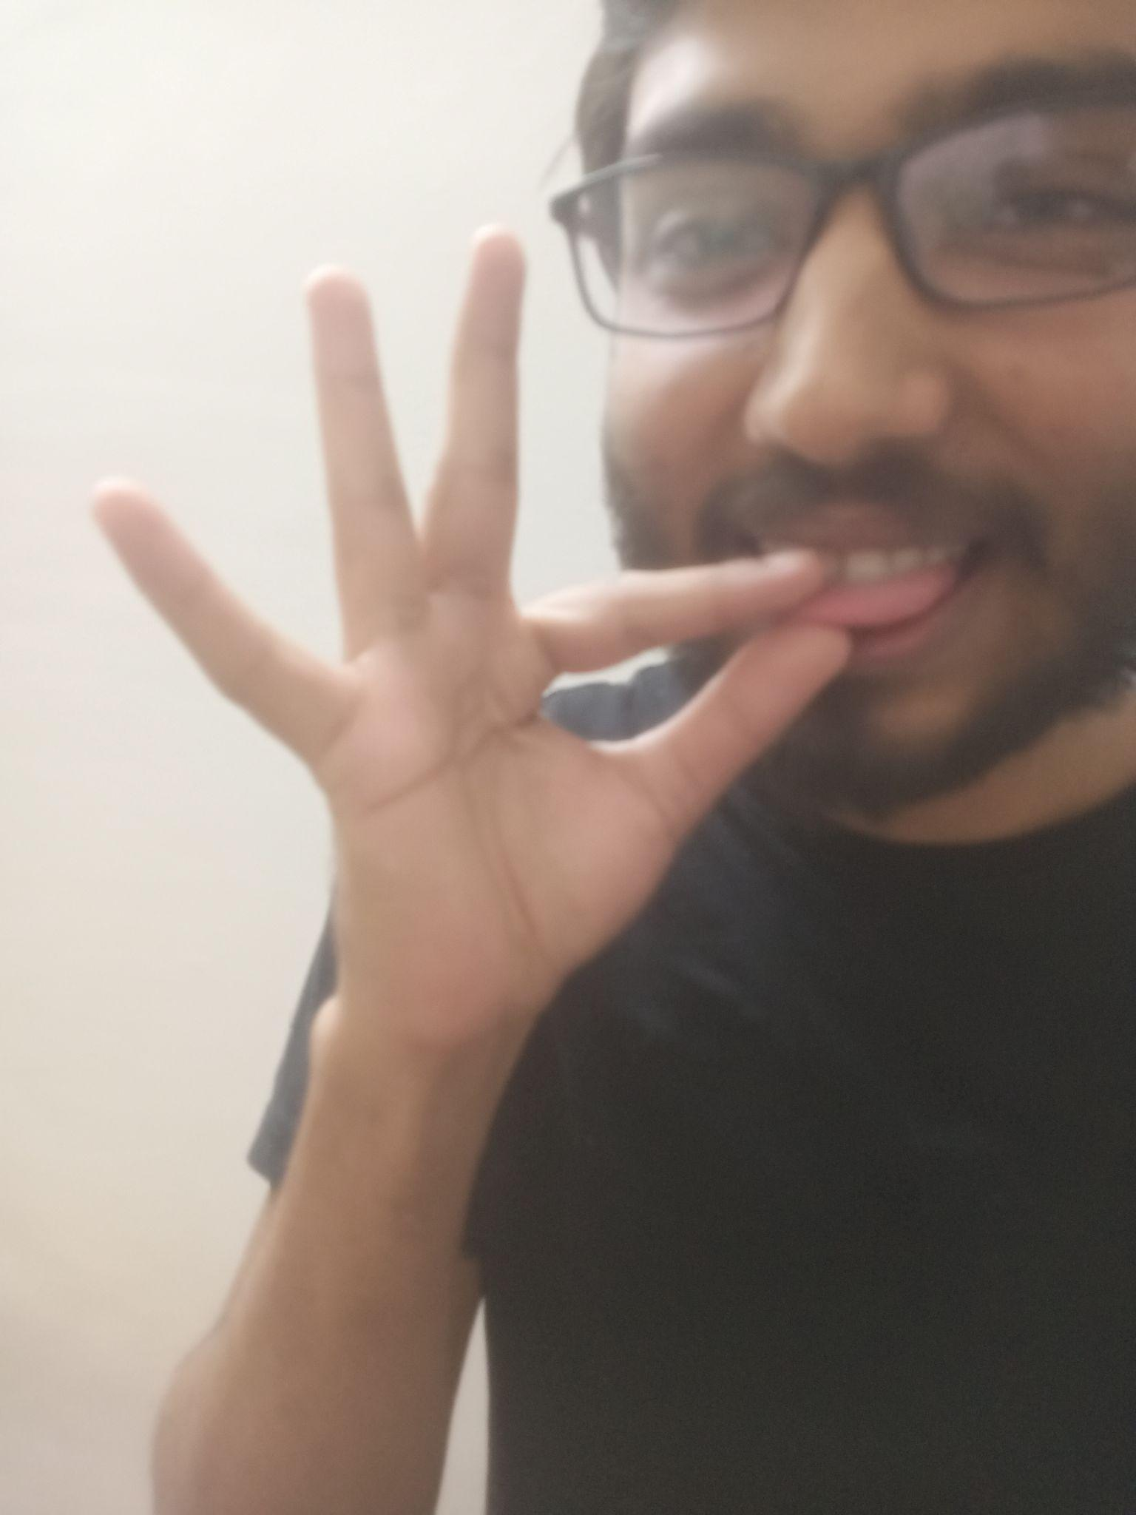
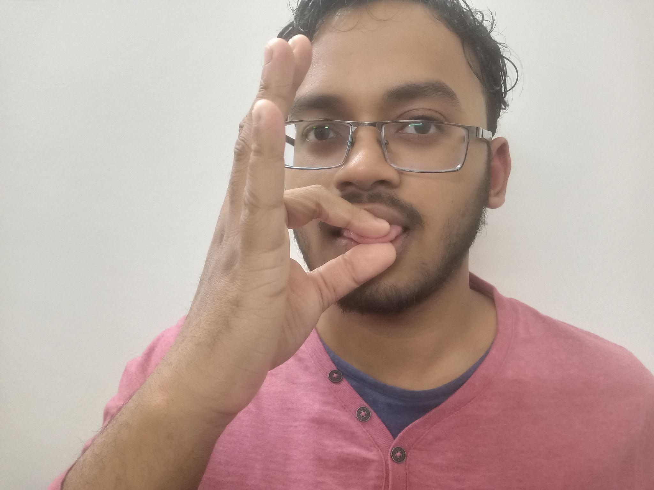
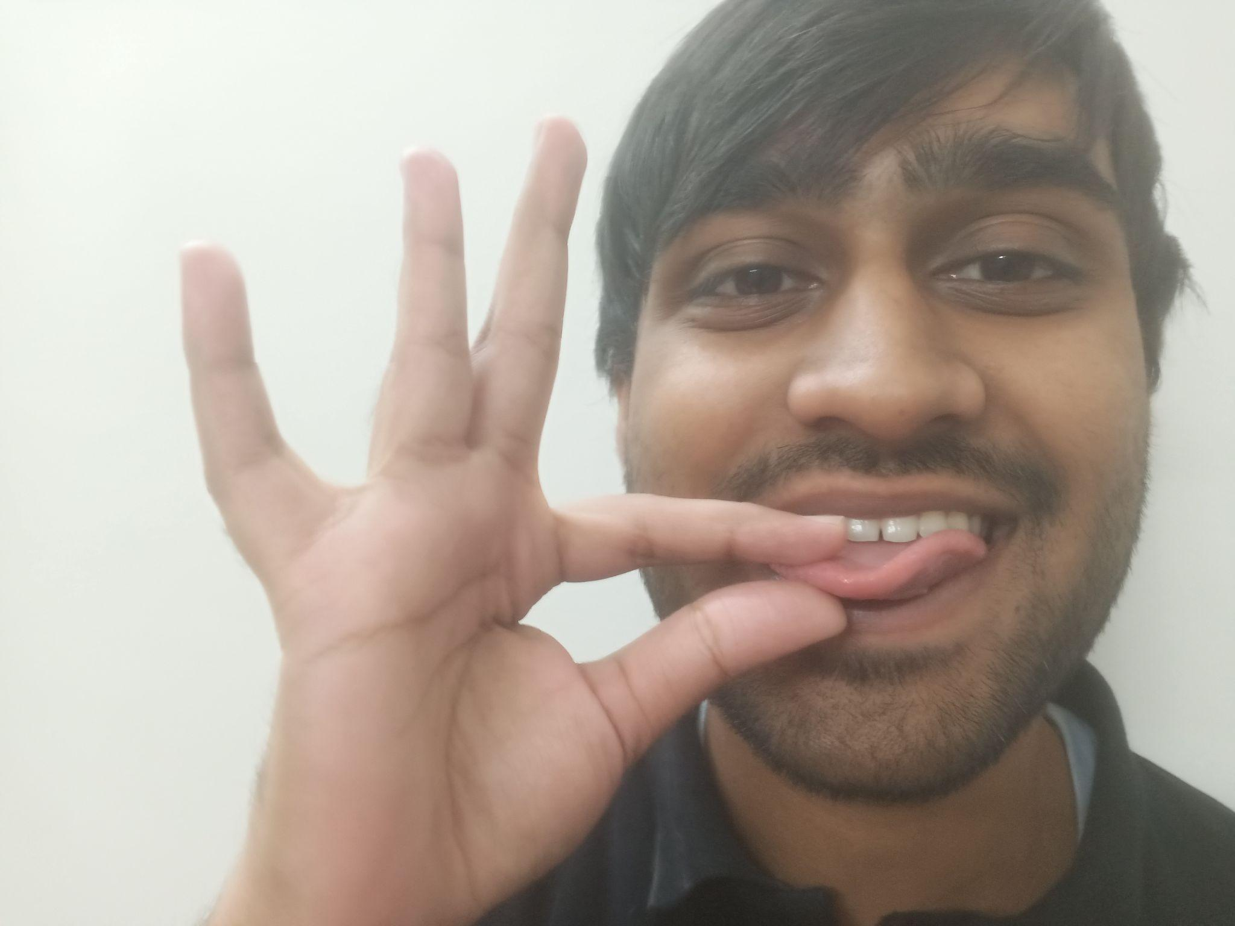
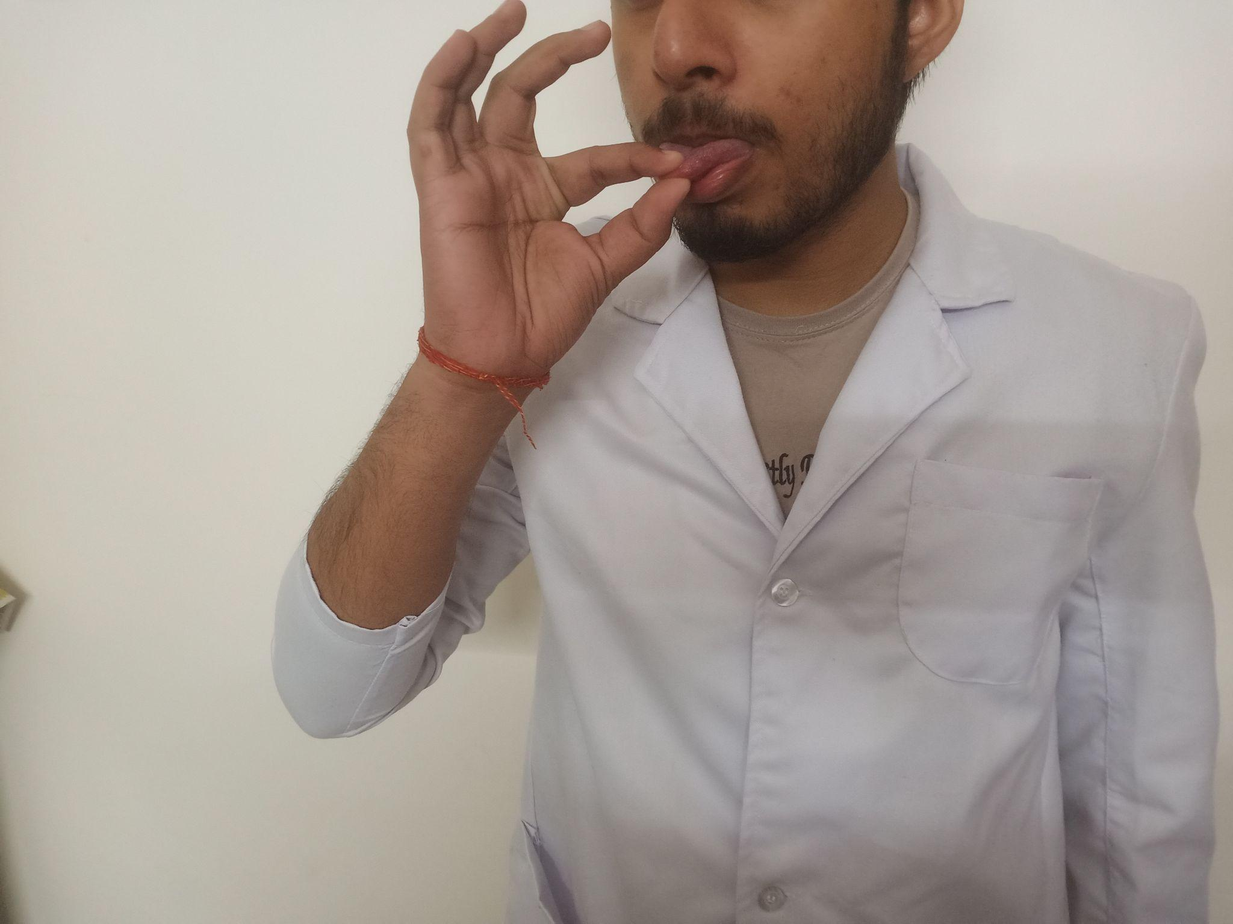
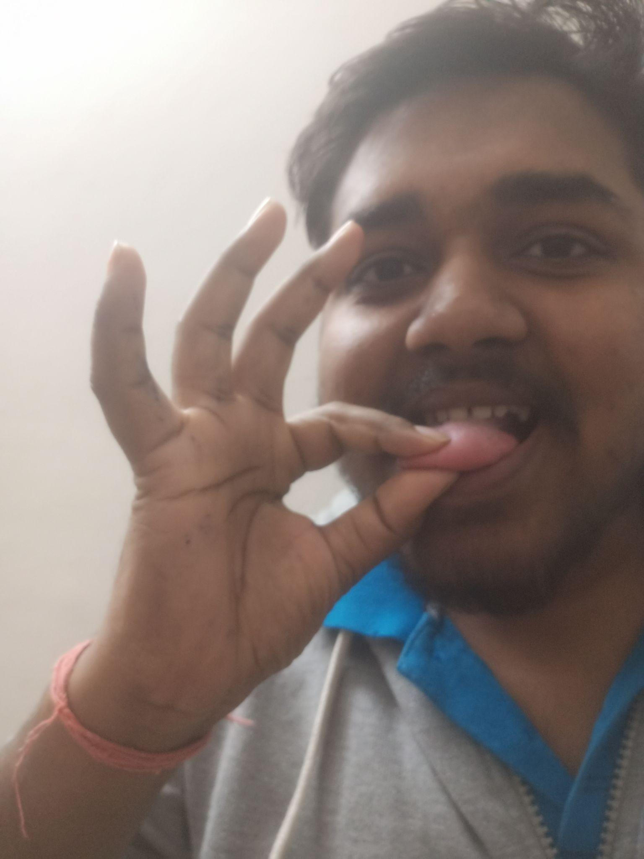
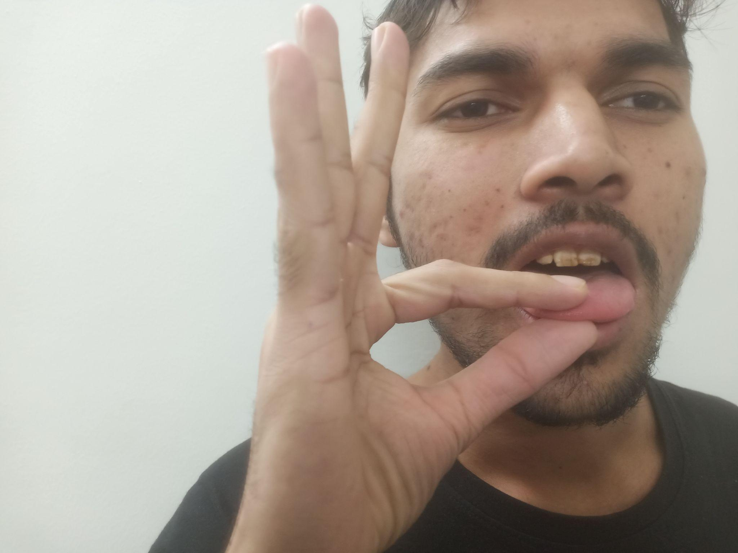
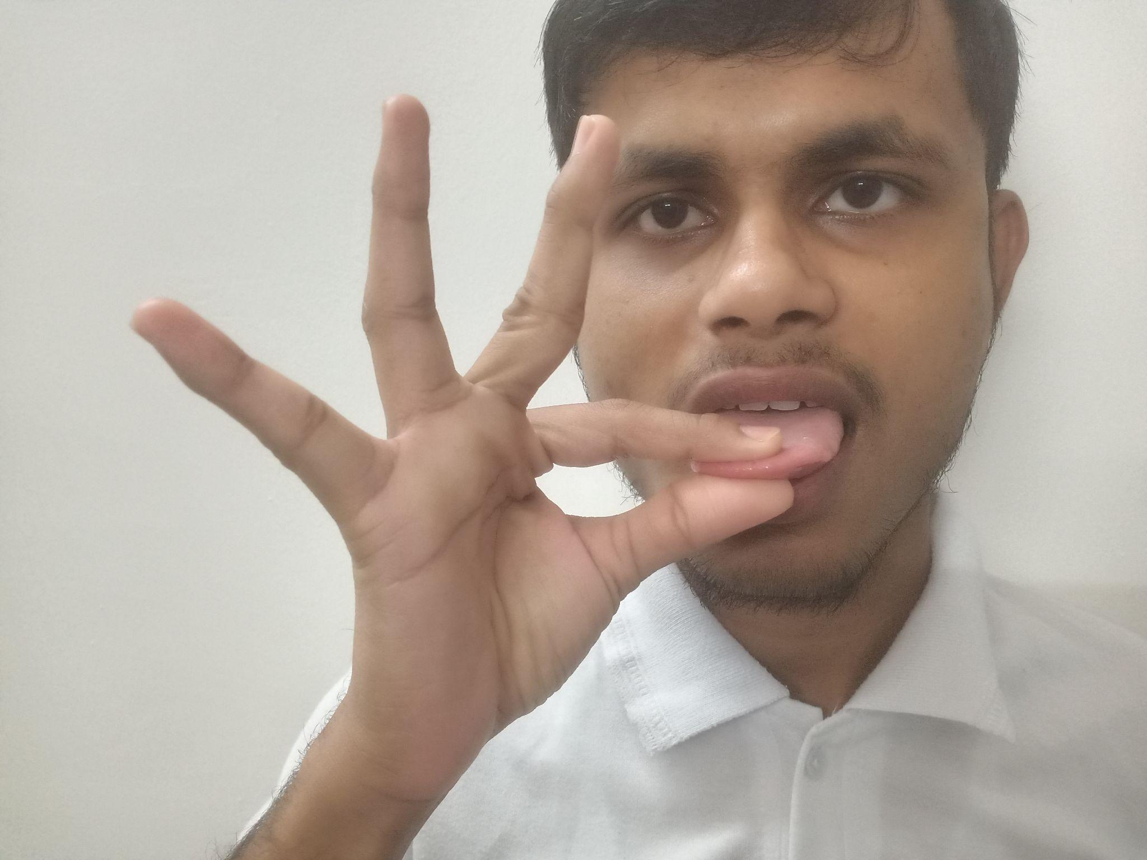
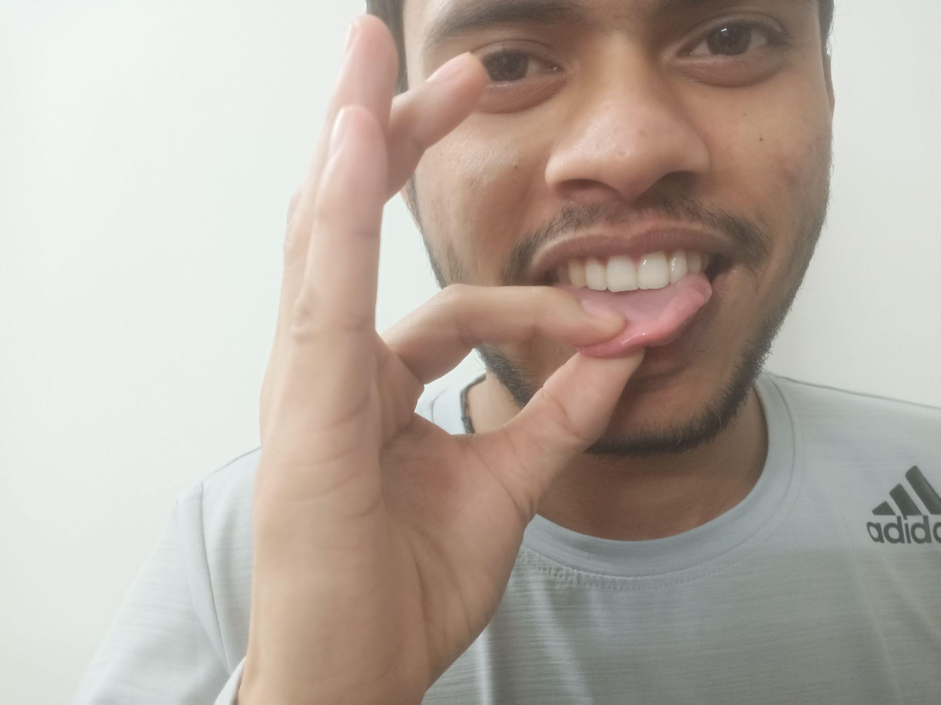
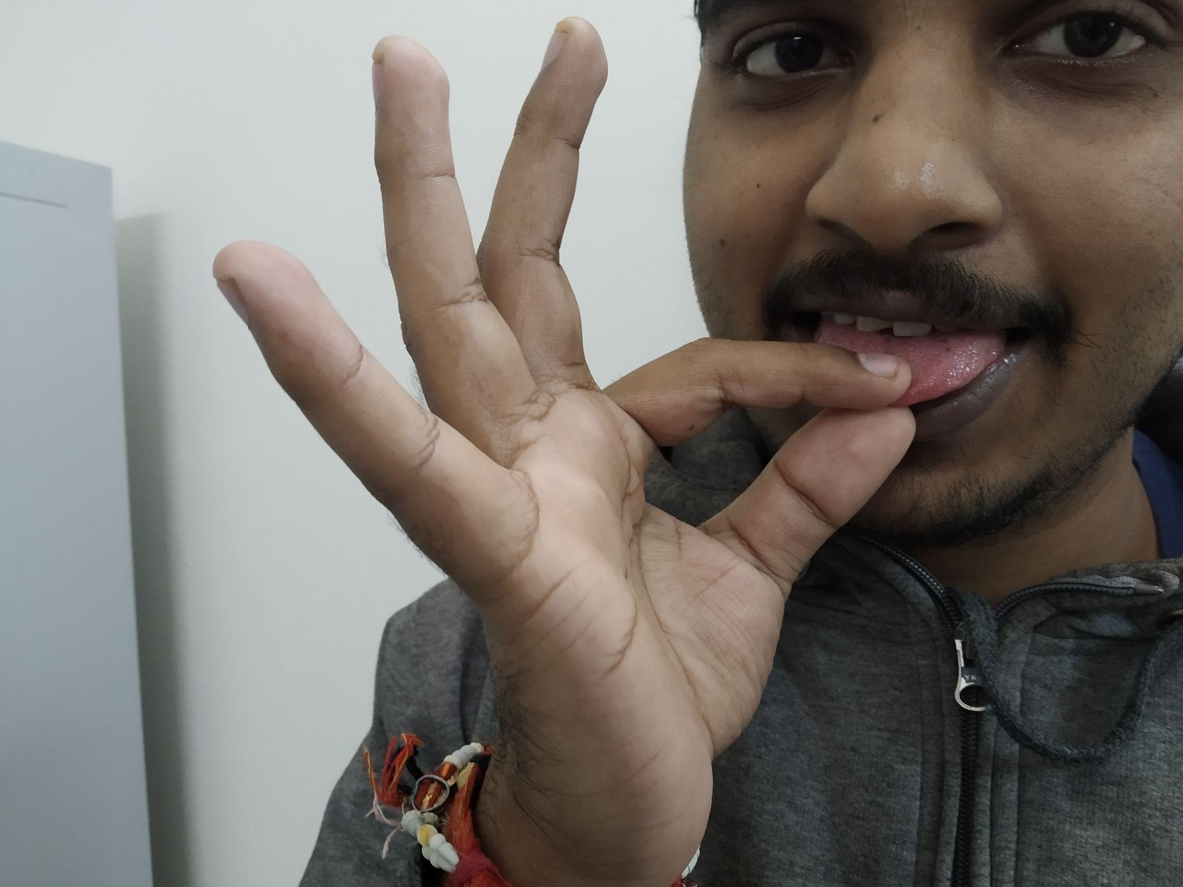
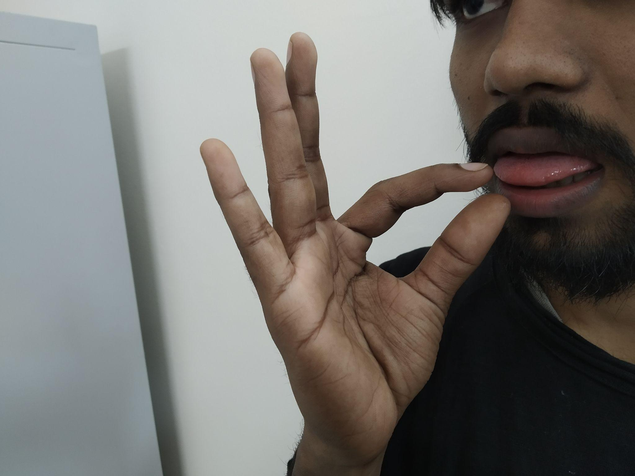
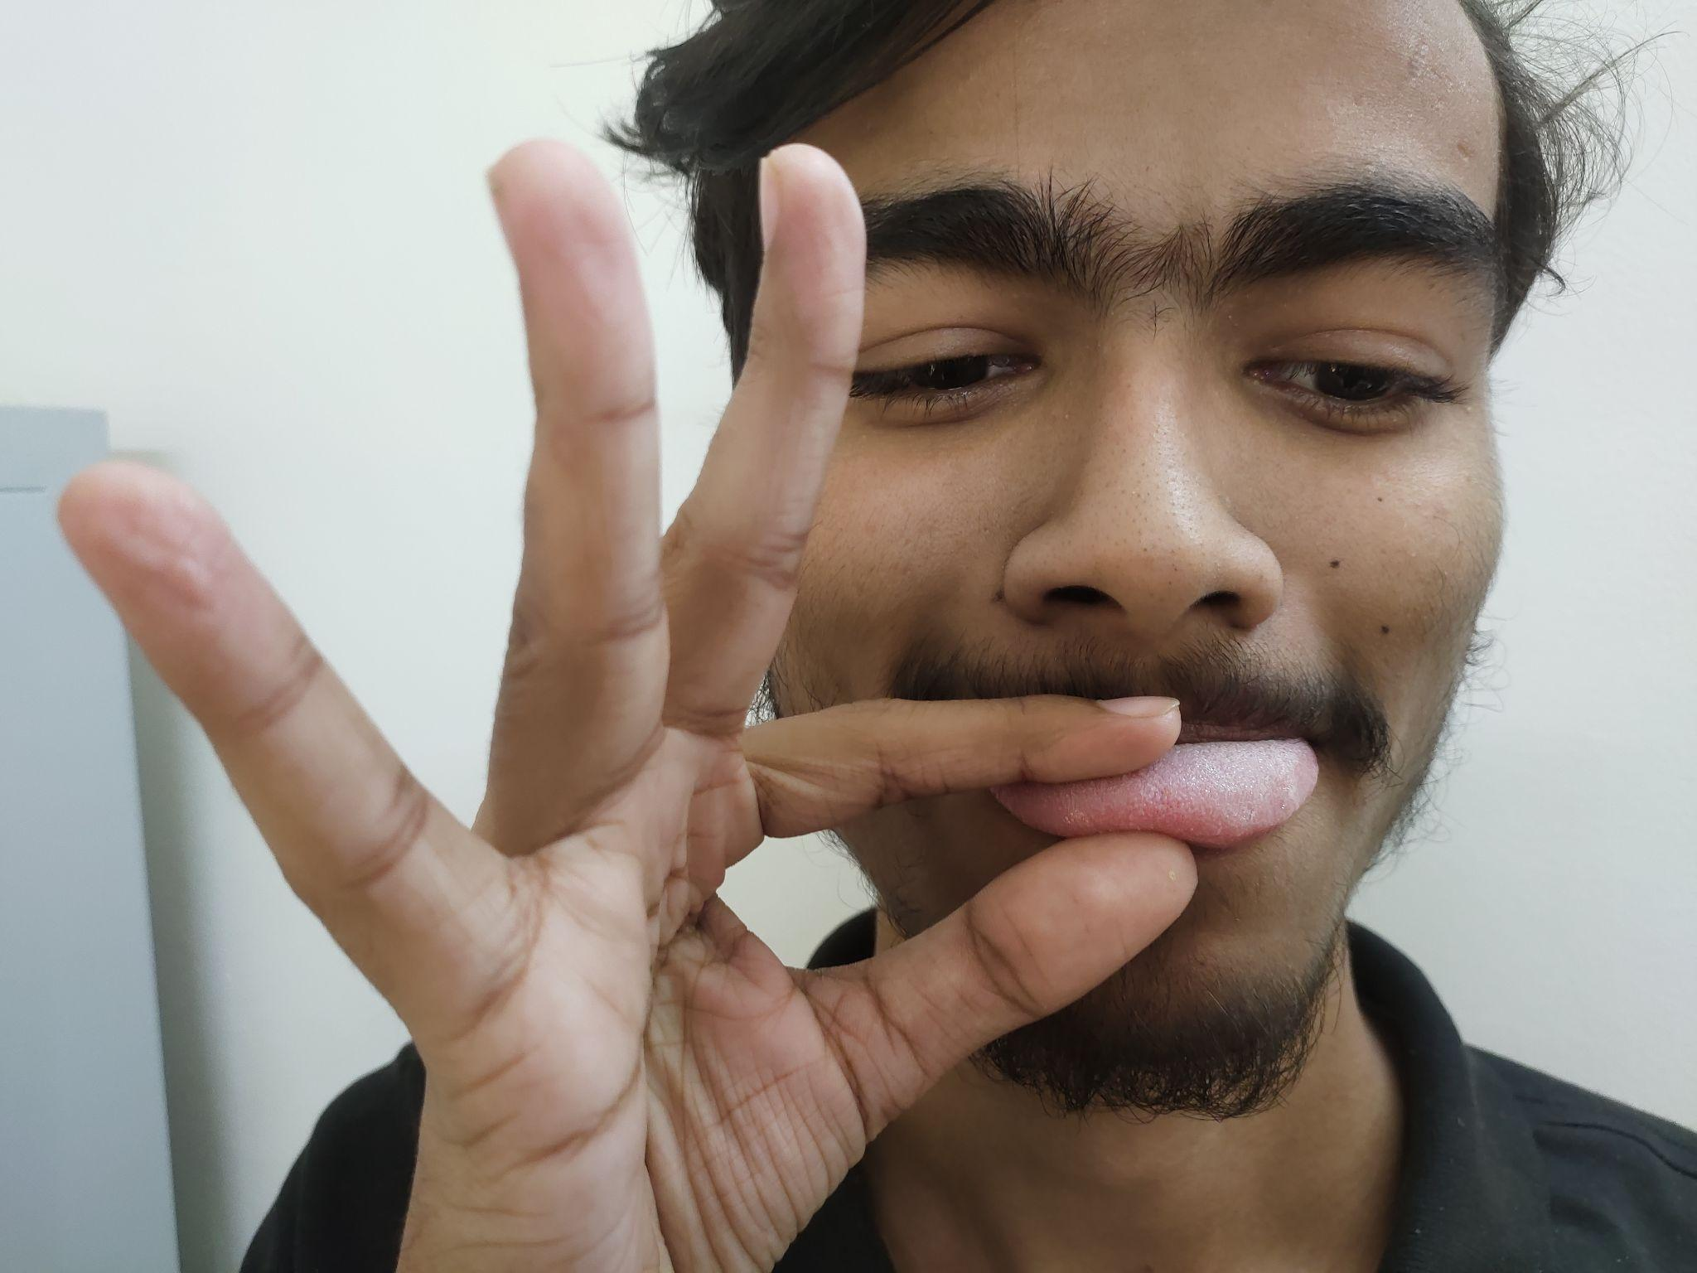
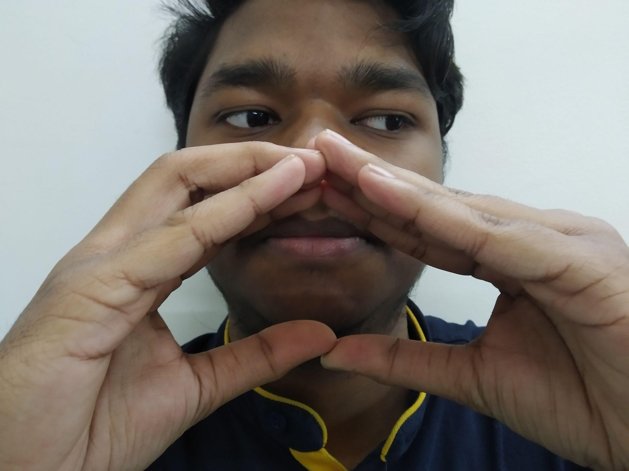
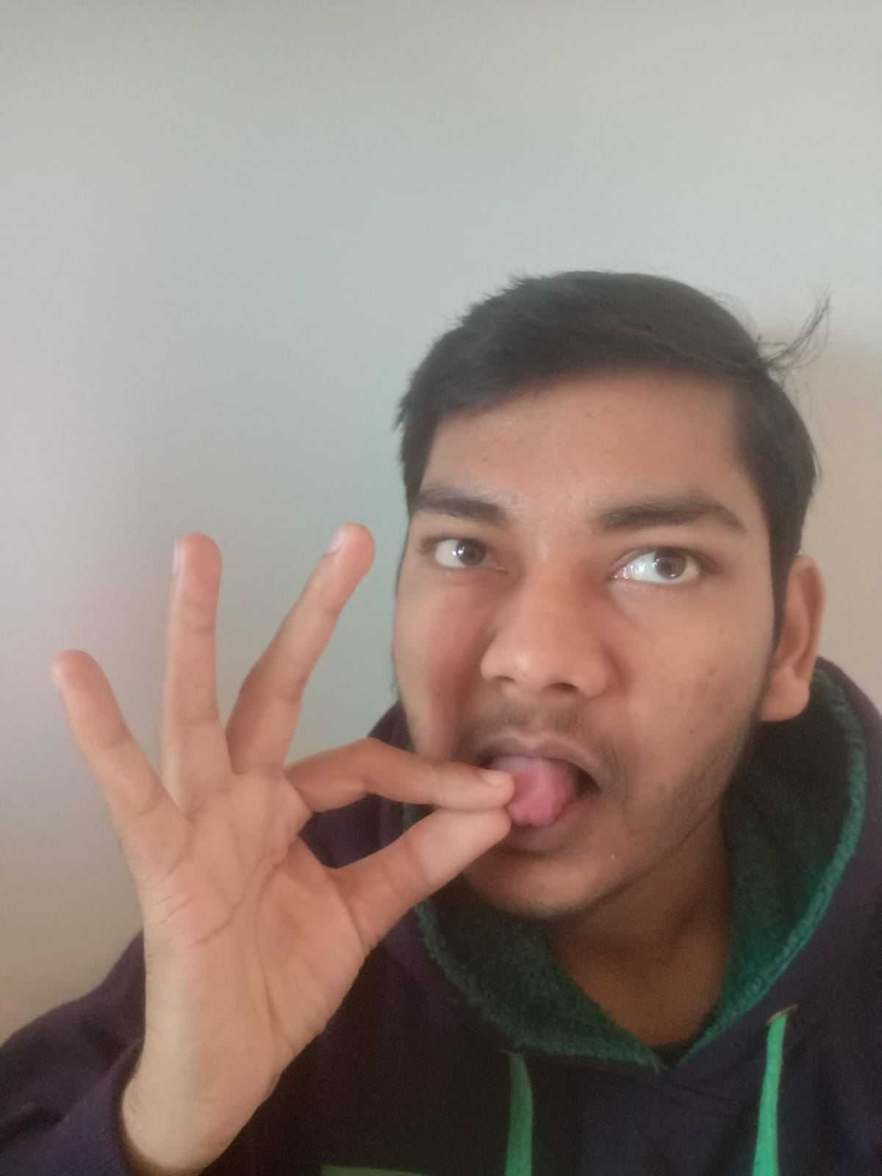
People from which we took our data set ( ‘tongue and burger symbol presented by them ,as it was the only symbol where face is visible!)

Slide 8
3 Data processing
Firstly we have to sort the training data along with its labelling.
After that our task is to do segmentation on our training dataset, so that we can distinguish between human skin and other stuff in the picture.
We will be using tensorflow framework to make our deep learning model in order to train the dataset.

Slide 9
4 Training
Training of the model will use the parameters obtained from a file that will list the learning rate , image filtering , batch size and number of epochs. The model will be tested every epoch and the model with best accuracy is saved for further testing. On finishing the training , the error and loss will be saved.
Prerequisites softwares & Libraries.:
1.OpenCV
2.Keras.
3.Tensorflow.

Slide 10
5 Recognition of Sign
After training the model , it can be used to identify the gestures of the Indian sign language on which it was trained.
Further the project can be extended to recognise more and more symbols of the indian sign language by training it with the dataset of appropriate symbols.

Slide 11
Data Processing
The most important part of data processing in sign language recognition is to make the skin stand out in the picture. So first step in data processing is skin segmentation. Then by using the algorithm of connected component we can do the hand segmentation, in order to get clearer training dataset..

Slide 12
Challenges
No standard datasets for Indian Sign Language, not even for letters and we chose the task of recognizing words.
Using two hands leads to occlusion of features
Variance in sign language with locality and usage of different symbols for the same words by the same person.
All the data set available was in video form, and most of the symbols have motion in them , so we had to carefully select those symbols which are static , so that its image can be taken.

Slide 13
Outcome
Our project aims at taking the basic step in bridging the communication gap between normal people and deaf and dumb people using Indian Sign Language.
An efficient sign language recognition (SLR) system would help speech and hearing-impaired people to communicate with normal people. Effective expansion of this project may not only make the deaf and dumb people communicate faster and easier with the outer world, but also provide a boost in developing autonomous systems for understanding and aiding them.

Slide 14
Post Midsem

Slide 15
Data Preprocessing
We divided the data preprocessing into two parts before training our sign language dataset.

Slide 16
Data Preprocessing
We divided the data preprocessing into two parts before training our sign language dataset.
Classifying the dataset.

Slide 17
Data Preprocessing
We divided the data preprocessing into two parts before training our sign language dataset.
Classifying the dataset.
Data Labelling.

Slide 18
Data Preprocessing
We divided the data preprocessing into two parts before training our sign language dataset.
Classifying the dataset.
Data Labelling.
Skin Segmentation.

Slide 19
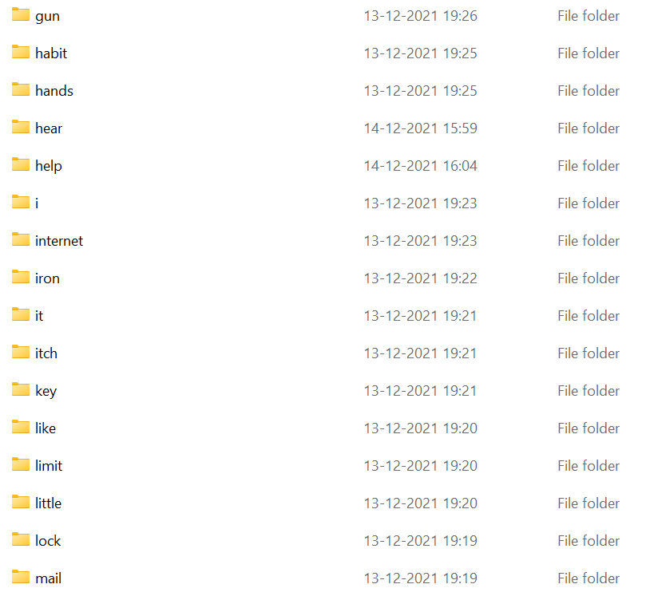
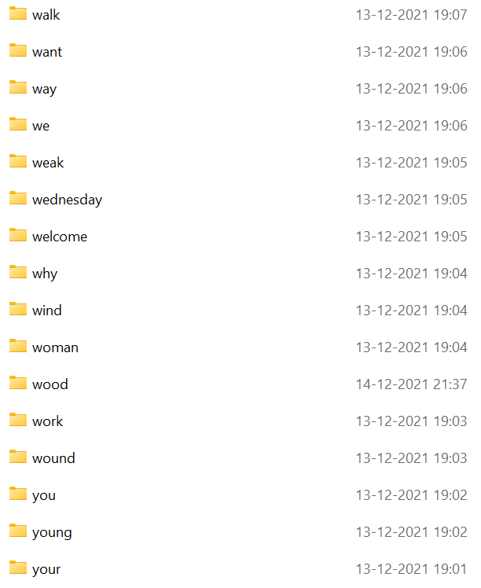
Data Labelling
Labels of 32 out 83 symbols

Slide 20
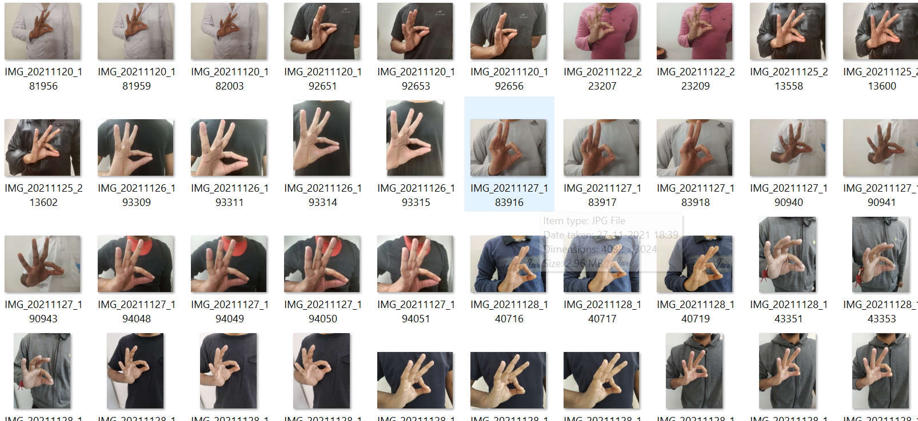
Data Labelling
Dataset of label “good”

Slide 21
Skin Segmentation

Slide 22
Skin Segmentation
Skin Segmentation deals with the recognition of skin-colored pixels and regions in a given image.
Our skin segmentation method followed the following procedure:

Slide 23
Skin Segmentation
Skin Segmentation deals with the recognition of skin-colored pixels and regions in a given image.
Our skin segmentation method followed the following procedure:
First we converted our image from BGR to HSV color space.

Slide 24
Skin Segmentation
Skin Segmentation deals with the recognition of skin-colored pixels and regions in a given image.
Our skin segmentation method followed the following procedure:
First we converted our image from RGB to HSV color space.
Then we used the inRange function of OpenCV library with the help of which we can mask out image and convert the images into binary.

Slide 25
Results of our Segmentation

Slide 26
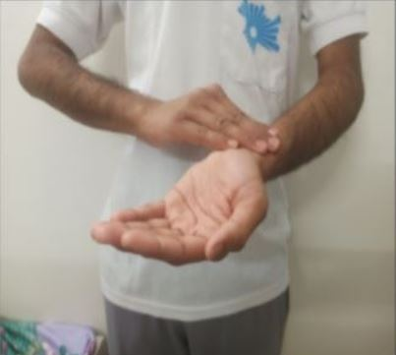
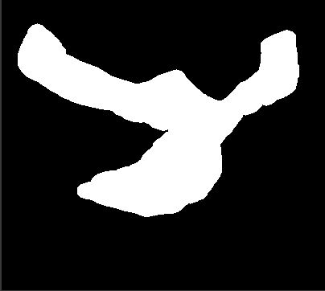
Sample I
Doctor
Before Skin Segmentation After Skin Segmentation

Slide 27
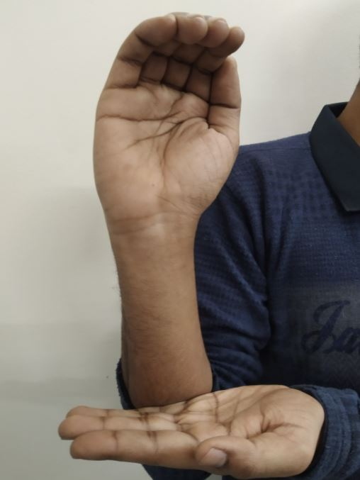
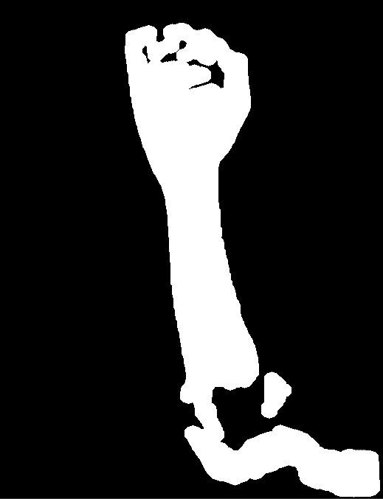
Sample II
Snake
Before Skin Segmentation After Skin Segmentation

Slide 28
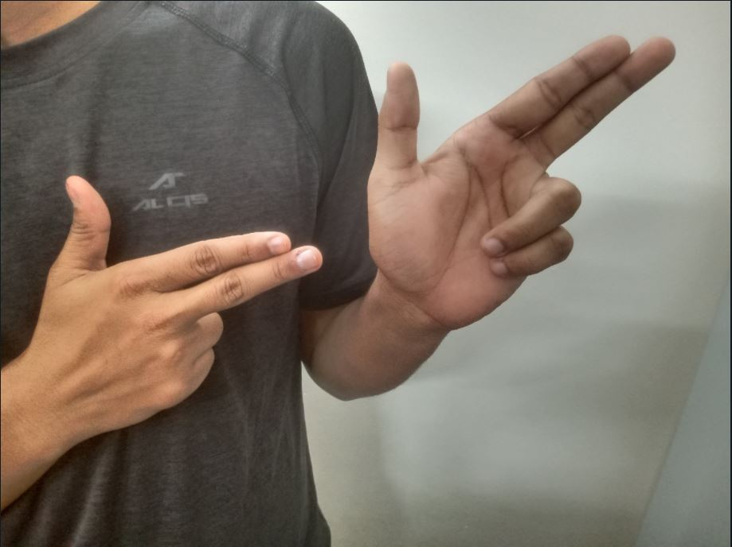
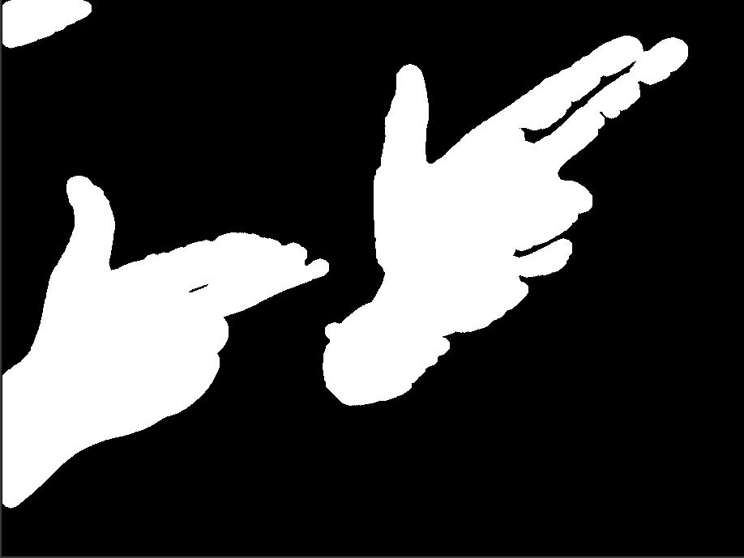
Sample III
Gun
Before Skin Segmentation After Skin Segmentation

Slide 29
Skin Segmentation Code

Slide 30
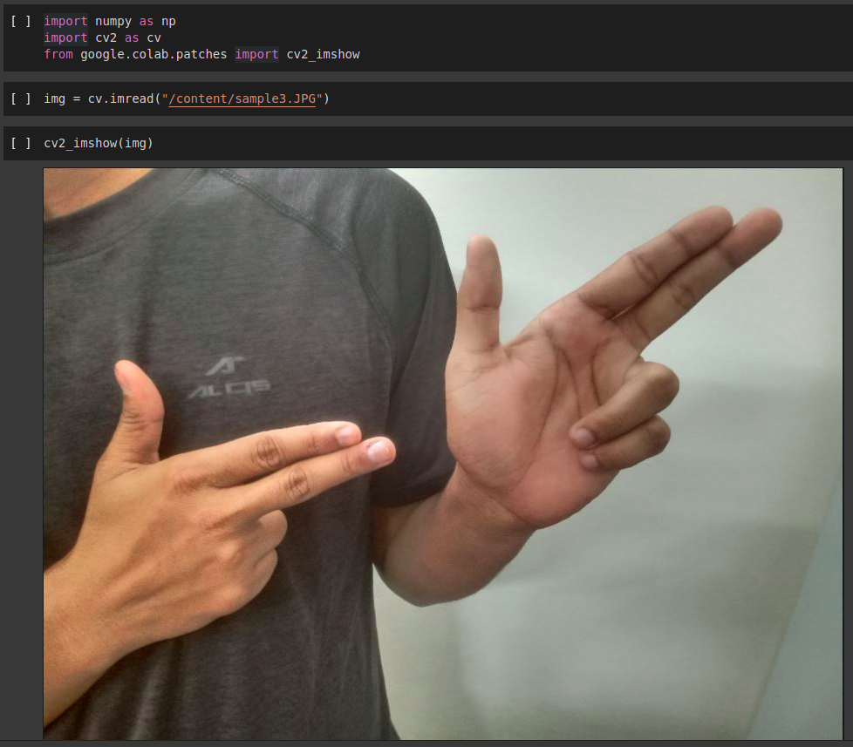
Skin Segmentation Code
Importing libraries and
reading the image

Slide 31
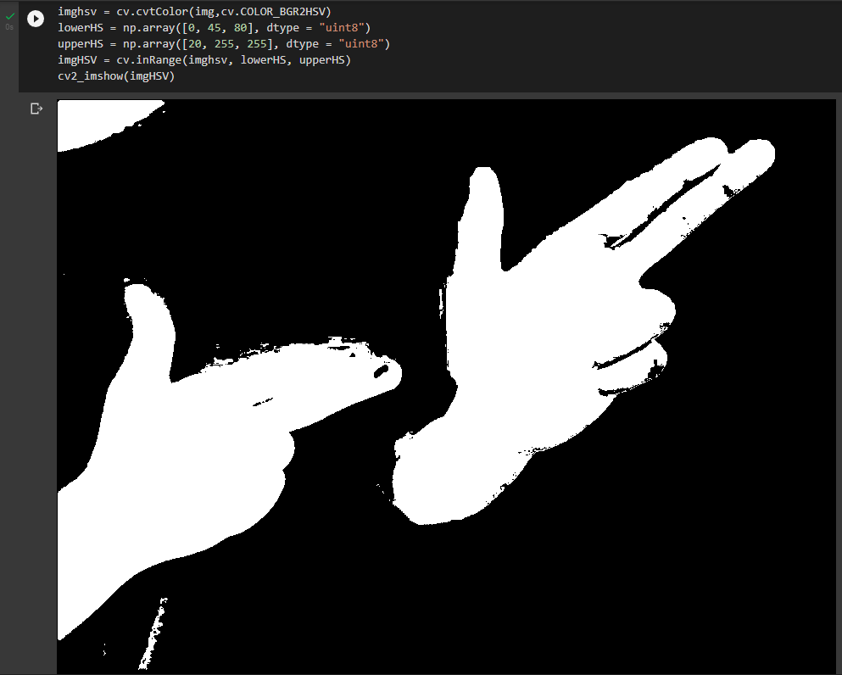
Skin Segmentation Code
2) Image Masking

Slide 32
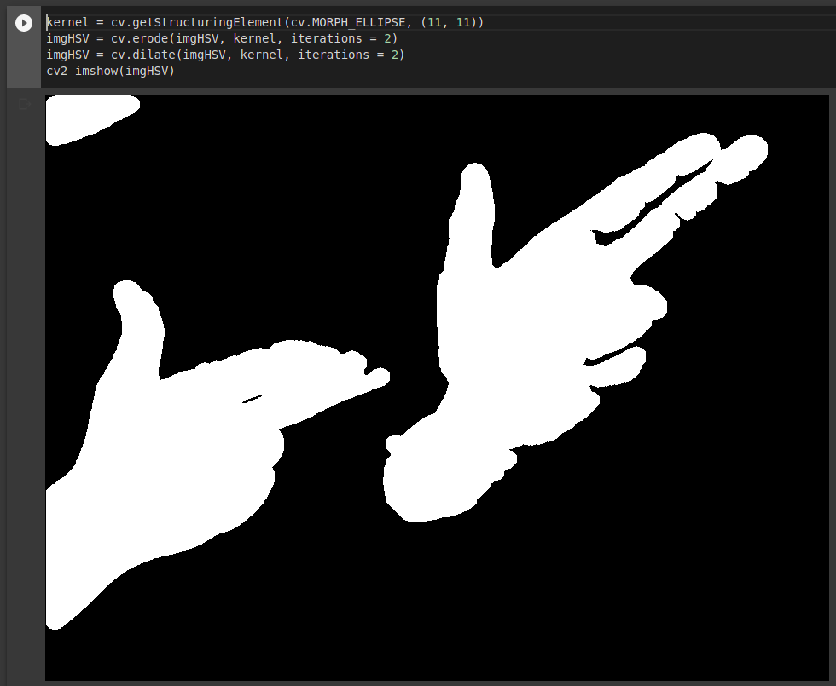
Skin Segmentation Code
3) Rectifying some errors

Slide 33
Skin Segmentation Code
Working code:
https://github.com/abhayishere/Sign-Language-Recognition-Model/blob/main/skin_segmentation.ipynb
Real time working code:
https://github.com/nsachin08/opencv/blob/main/Hand.py

Slide 34
Segmentation on full dataset.
Before training the model we had to apply the skin segmentation code over our full dataset.

Slide 35
Segmentation on full dataset.
Before training the model we had to apply the skin segmentation code over our full dataset.
Which we were not able to because of the following difficulties.

Slide 36
Segmentation on full dataset.
Before training the model we need to apply the skin segmentation code over our full dataset.
Which we were not able to because of the following difficulties.
The limitations of free version of Google Colab.

Slide 37
Segmentation on full dataset.
Before training the model we need to apply the skin segmentation code over our full dataset.
Which we were not able to because of the following difficulties.
The limitations of free version of Google Colab.
Our dataset has more than 5000 images, so by doing the math it will take more than 83 hours to do complete segmentation in the free version of google colab.

Slide 38
Recap of This semester
What has been done:

Slide 39
Recap of This semester
What has been done:
1> Signwise dataset is labelled and ready for segmentation and further processing.

Slide 40
Recap of This semester
What has been done:
1> Signwise dataset is labelled and ready for segmentation and further processing.
2> Dataset of 83 symbols ( about 5100 images ) are collected completely.

Slide 41
Recap of This semester
What has been done:
1> Signwise dataset is labelled and ready for segmentation and further processing.
2> Dataset of 83 symbols ( about 5100 images ) are collected completely.
3> Programming for segmentation is done and tested.

Slide 42
Recap of This semester
What has been done:
1> Signwise dataset is labelled and ready for segmentation and further processing.
2> Dataset of 83 symbols ( about 5100 images ) are collected completely.
3> Programming for segmentation is done and tested.
4> Learning phase ( for this particular project ) is almost completed for all the members.

Slide 43
Individual Contribution:
Chandan Kumar: Collected 800+ images for our dataset, and sorting of data along with preparation of project reports.
Anant Kumar: Collected 800+ images for our dataset, and sorting, merging of data along with preparations of project reports and skin segmentation.
Sachin Naik: Learned and implemented skin segmentation in real time using OpenCV, also collected 800+images for our dataset.
Balwant Yadav: Labelling of our sign language dataset, also collected 800+images for our dataset along with preparation of presentations.
Abhay Yadav: Learned and implemented skin segmentation using OpenCV and started building sign language classification model using tensorflow, also collected 800+images for our dataset.
Anshul Sharma: Selection of 83 static symbols for our dataset from Indian sign language , Collected 800+ images for our dataset and learned image segmentation by watershed algorithm using OpenCV .

Slide 44
Thank You

Slide 45
Next Semester:

Slide 46
Next Semester:
Complete segmentation of our sign language training dataset.

Slide 47
Next Semester:
Complete segmentation of our sign language training dataset.
Start building our Image Classification model via fine tuning with the EfficientNetB0.

Slide 48
Next Semester:
Complete segmentation of our sign language training dataset.
Start building our Image Classification model via fine tuning with the EfficientNetB0.
Loading the data into Google Colab
Dividing the dataset into training and testing dataset of 4:1 ratio.
Normalization of our dataset
Batching of our dataset
Training our data with the help of EfficientNetB0 using Transfer Learning.

Slide 49
Final Sign language Recognition model
Along with our Segmentation we were also trying to build our sign language recognition model since past week, which is currently under work in progress.
Work in progress tensorflow code for the model:
https://github.com/abhayishere/Sign-Language-Recognition-Model

Slide 50
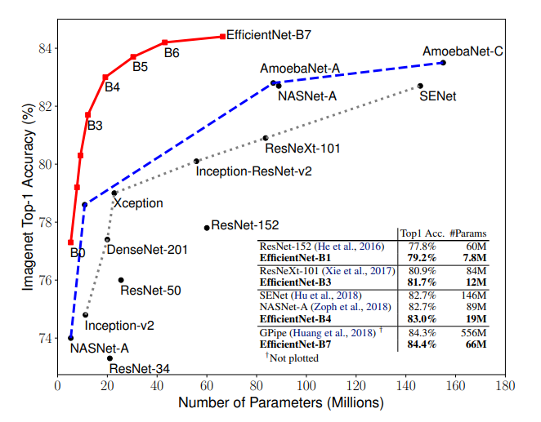
Why EfficientNet Model?
These are some of the classification models, and we choose EfficientNet-B0 over EfficientNet-B7 because EfficientNet-B0 has only 237 layers whereas EfficientNet-B7 has 813 layers. As we are already suffering from time constraints, firstly we will try to train our model on B0 than in order to enhance our recognition model we can try to train on EfficientNetB7.

